Slide 1
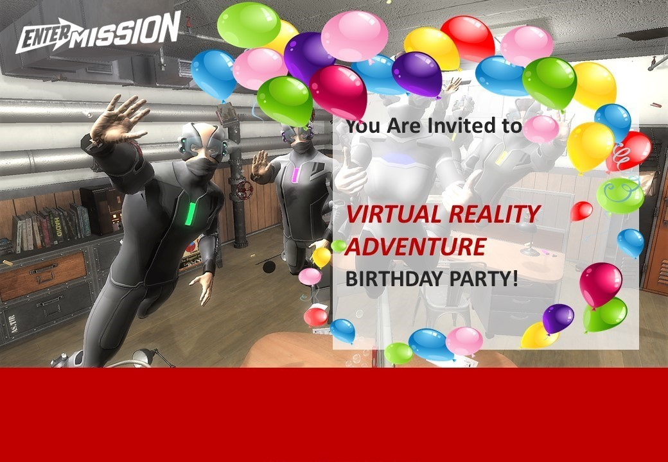
<INSERT NAME>
<INSERT DATE & TIME>
Level 1, 164 Bourke Street Melbourne
Opposite Russell Street Tram Stop 7. Parking is at Wilson Secure Parking at 180 Russell Street.
Level 1, Bourke St, Melbourne
Nearest tram station is . Nearest car parking at .
RSVP to <Insert Name & Email / Phone> by <Insert Date>
www.enterthemission.com/melbourne

