Slide 1
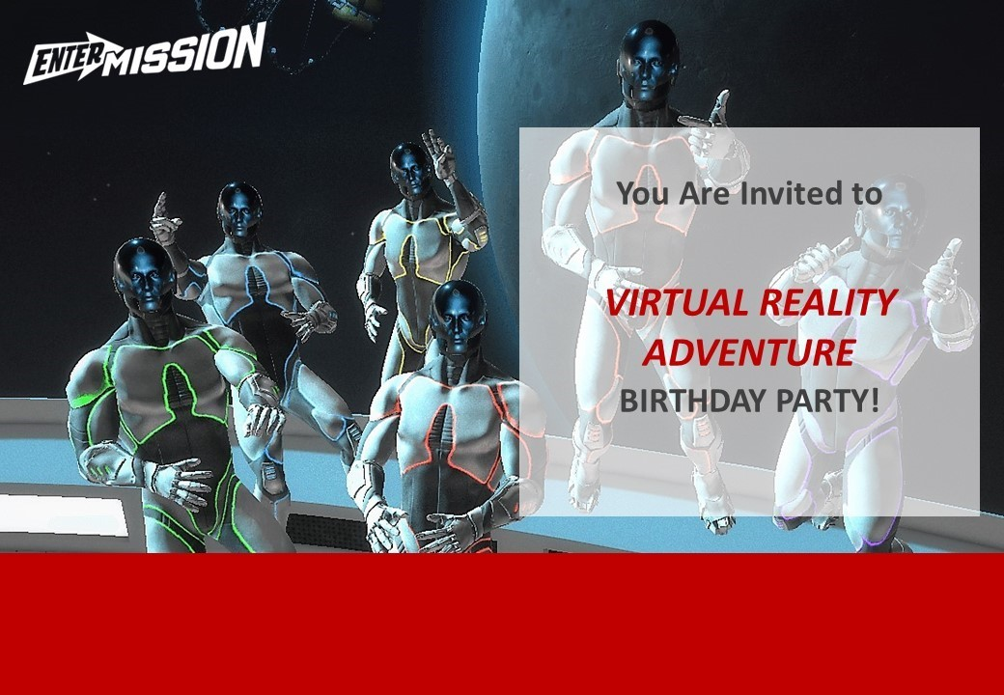
<INSERT NAME>
<INSERT DATE & TIME>
Level 1, 164 Bourke Street Melbourne
Opposite Russell Street Tram Stop 7. Parking is at Wilson Secure Parking at 180 Russell Street.
RSVP to <Insert Name & Email / Phone> by <Insert Date>
www.enterthemission.com/melbourne

